Slide 1

VICTORIA PLAYING FIELDS FOOTBALL CLUB (VPFC)
2024 - 2025

Slide 2
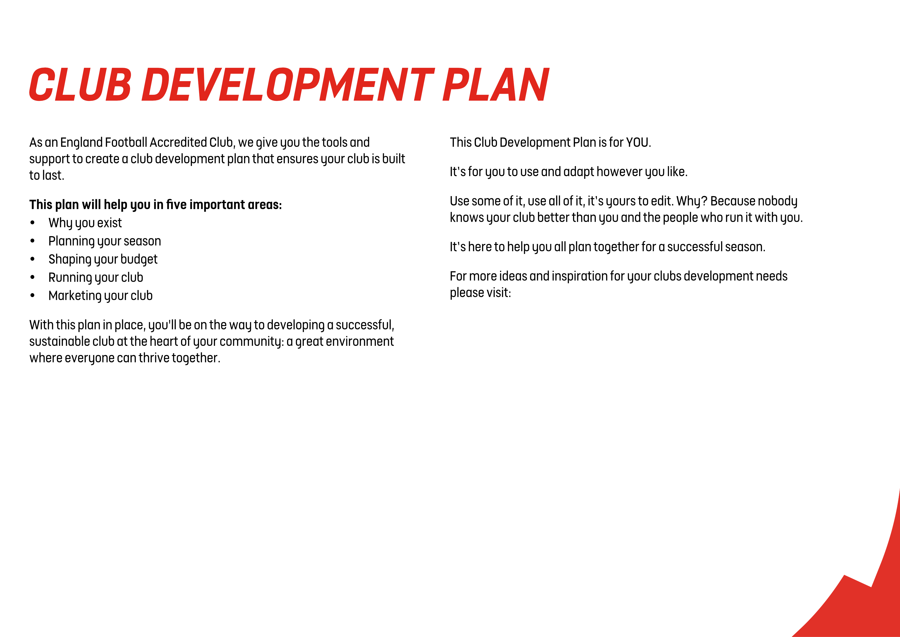
VPFC
The Leagues and Clubs YouTube Hub.

Slide 3
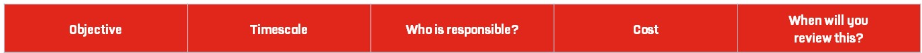
Use this planner to set goals and create tasks to complete which will
help you understand your clubs vision, and what its purpose is.
Tip: Visit our England Football League and Club Hub on YouTube
for ideas and insights to help you develop a vision and mission for your club.
Inclusivity Foster a love of football in a friendly and inclusive environment. | Ongoing | Committee | No direct costs. Capturing “Why We Exist”, is about defining club Ethos rather than projects or initiatives. | Annually – on refreshing club accreditation.
Activity Encourage participation in sports, focusing on skill development and enjoyment. | Ongoing | Committee | As Above | Annually – on refreshing club accreditation.
Community Promote community spirit and teamwork among young children. Create community connections between parents. | Ongoing | Committee | As Above | Annually – on refreshing club accreditation.
Development Provide pathways for children to progress to league football, ensuring continued development and opportunities. | Ongoing | Committee | As Above | Annually – on refreshing club accreditation.

Slide 4
SEASON 2024/25
Use this planner to set the goals and tasks you need to complete for a positive season on and off the pitch. Think about what needs to happen both monthly and weekly.
Tip: Visit our England Football League and Club Hub on YouTube for ideas and insights to help you plan ahead for a successful season.
Launch a League Team Launch an U10 team in the Herts Youth League | Launch: Sept 2024 Mature: All season, 2024/25. | Club: Chairman Team: Team Manager | League Membership: £100 Pitch Hire: £100 x 10 Equipment: Circa £500 | Termly Committee Meetings
Broaden Certification Have at least two coaches in each year with First Aid and Coaching Qualifications | July 2025 | Lead: CWO’s Support: Committee, Head Coaches | 7 x First Aid course (£30) 7 x Intro to Coaching (£100) = £210 + £700 = £910. | Termly Coaches Meetings
Gain Licences Gain Licences from the Council for the use of VPF and The Brickie | September 2024 | Chairman | 2 x £100 (Fee for Surveyor to write licences) = £200. | First Committee Meeting of the Year
Add Coaches Add coaches across all groups to replace those moving to lead and add resilience | November 2024 (Continuing all year, but main push in first term, when most new members join) | Lead: Head Coaches Support: CWO’s | £10/coach for DBS Total around: £150 | Termly Coaches Meetings
Add Females Add female players, coaches and committee members, balancing membership | Whole Season | All Volunteers | No direct costs. | Termly Coaches Meetings

Slide 5
SEASON 2024/25
Use this planner to set the goals and tasks you need to complete for a clear plan for your club budget and finances.
Tip: Visit our England Football League and Club Hub on YouTube for ideas and insights to help you with your club finances.
Fund Winter Training Cover costs of offsite training at HRFC from December to March | By Booking Start in December | Treasurer | £55 x 3 hours x 12 weeks: £1980 | First Committee Meeting of Season
Support League Team Cover all costs for establishment of first league team | Equipment, Kit by early September. Pitch and Referee costs throughout the season. | Treasurer | Circa £2500 including: Pitches: £1000; Kit: £300; Goals: £250; Equipment: £300 | Treasurer update at Termly Committee Meetings through the Season
Provide Equipment Fulfil requests for new equipment across the club | Fresh equipment pack for Reception & New balls across club: Sept. Sundry requests: all year | Treasurer | £1500 | Treasurer update at Termly Committee Meetings through the Season
Trophies and Medals Supply trophies and medals for all teams at end of season. | Prize Giving in July | Treasurer | £400 | Final Committee Meeting of Season

Slide 6
Total Projected Income | £13,945 Skills Membership: £45 x 250 = £11,250 League Membership: £245 x 11 = £2,695
Total Projected Expenditure | £13,500 We’re budgeting to break even with a small contingency.
Annual Balance | £495

Slide 7
Use this planner to set goals and the tasks you need to complete to build your volunteer team. It can also be used to identify key responsibilities for those who are already playing their part in your club.
Tip: Visit our England Football League and Club Hub on YouTube for ideas and insights to help you make the most of the people at your club.
Onboarding Invite volunteering in welcome emails | Ongoing | Club Secretary – ensure consistent welcome email template exists, is continually improved and is reliably sent | None | Termly Committee Meetings
Website Maintain updated Volunteering page on club website | Ongoing | Technology Manager | None. (No incremental cost to update the page). | Termly Committee Meetings
Club Comms Periodic cascades from committee through Pitchero and Signal | Ongoing | Committee | None | Termly Committee Meetings
Team Comms Regular mention of volunteering in Signal comms and in-person | Ongoing | Lead: Head Coaches Support: Coaches, Team Admins | None | Termly Coaches Meetings

Slide 8
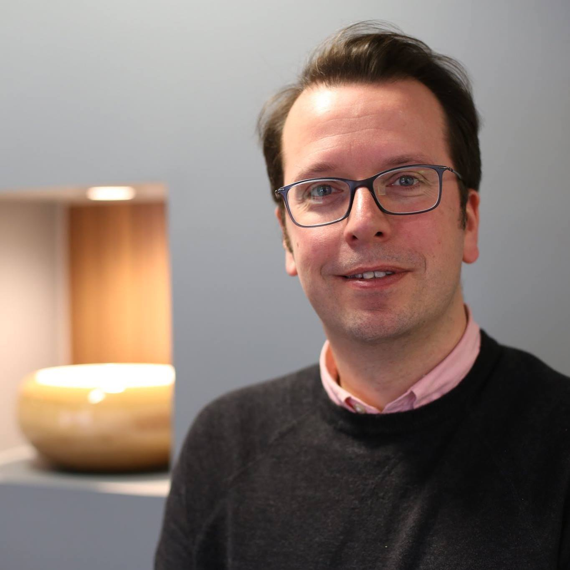
TREASURER
Gordon Baisley has volunteered with VPFC for 8 years. Initially coaching his eldest son, then as Head Coach for his middle son’s group, becoming Chair in 2017.
Mike Hilary has been Treasurer since 2022. He has had two daughters play at VPFC and currently also coaches in Year 2.
ASSISTANT WELFARE OFFICER
Kate Hanks has been club secretary since 2023. She has two children at the club.
Caroline Rich has been Assistant Welfare Officer since 2023. She currently has two children playing at the club.
TECHNOLOGY MANAGER
Arianna Arcangeli has been Welfare Officer since 2023. She has two children playing at VPFC.
Adam Low has been club Technology Manager since 2023. He has one son playing at the club.

Slide 9
Use this planner to set goals and the tasks you need to complete to understand your market, and the methods you will use to listen to and communicate with them.
Tip: Visit our England Football League and Club Hub for ideas and insights into how to market your club and communicate effectively. Think about placement opportunities with local education providers, or give players within your club the opportunity to manage your online presence and social media content.
Coaches Feedback Listen to Coaches feedback from interactions with parents | Ongoing | Committee | None | Termly Coaches Meetings
News Articles Share what we are doing in the form of regular website news updates | Ongoing | Lead: Club Secretary Support: Technology Manager, Head Coaches | None | Termly Committee Meetings
Instagram Make use of our effort to get photo permissions by launching visual Instragram account | Ongoing | Lead: Club Secretary Support: Technology Manager, Head Coaches | None | Termly Committee Meetings

Slide 10
England Football Resources
England Football – Leagues & Clubs
England Football Accreditation
Club Learning Opportunities
YouTube - The League and Club Hub
England Football Learning
Club Resources
Club Structures Guide
Contact details for County FAs
Other Grassroots Support
Football Foundation
Football Foundation – Local Plans
Sport England
Sport England – Funding

